Slide 1
Retail 📊 Sales Data Cleaning and Exploration Project

Slide 2
🧾 Project Objective
This project focuses on cleaning, transforming, and performing exploratory data analysis (EDA) on raw sales data to extract meaningful business insights such as profit trends, customer segmentation, and performance metrics

Slide 3
📁 Dataset Overview
Multiple CSV files were provided containing raw sales data with the following typical structure:
Order ID
Customer Name
Order Date
Sales
Cost
Region
Product Category
... and more.

Slide 4
🔧 Data Cleaning Steps
Schema Documentation:
Loaded all CSVs and documented column types and formats.
Missing Values Handling:
Filled missing values with appropriate defaults or dropped irrelevant rows.
Standardized Formats:
Cleaned text columns (e.g., trimmed whitespace, consistent casing).
Converted monetary values and date columns to appropriate formats.
Removed Duplicates:
Identified and dropped duplicate records.
Data Type Conversion:
Ensured numerical columns (e.g., Sales, Cost) were floats.
Converted Order Date to datetime format.
Derived Columns:
Profit = Sales - Cost
Age Group (based on date of birth, if applicable)
Year-Month for time series grouping

Slide 5
📊 Exploratory Data Analysis (EDA)
Sales Trends:
Monthly sales visualized to identify seasonal trends.
Top Customers:
Ranked customers by total sales contribution
📈Visuals were created using Matpoltlib and seaborn

Slide 6
🧼 Output
Cleaned dataset saved to: cleaned_sales_data.csv
Notebook file: Sales_EDA.ipynb

Slide 7
💻 Technologies Used
Python (Pandas, NumPy)
Jupyter Notebook
Matplotlib, Seaborn
Git & GitHub

Slide 8
🗄️ SQL Database & Analysis
✅ Database SetupCreated relational schema with tables: customers, orders,products,returns.
Added foreign keys and indexes

Slide 9
🧮 Derived Metrics
Profit: sales – cost
Discount %: (discount / sales) * 100

Slide 10
📈 Business Questions Answered
Total sales,
profit, and Cost Monthly
sales trends Top
customers by revenue
Profitability by region
Category-wise discount analysis
SQL queries available in sql/ folder.

Slide 11
Objective
The objective of this Retail Sales Analysis dashboard appears to be to provide a clear snapshot of key performance metrics across gender, region, and product categories, helping stakeholders understand:
Overall profitability and sales volume
Return patterns and reasons, which can guide quality improvements
Customer segmentation (like gender distribution) to tailor marketing or inventory
Regional and store-type performance for better strategic planning

Slide 12
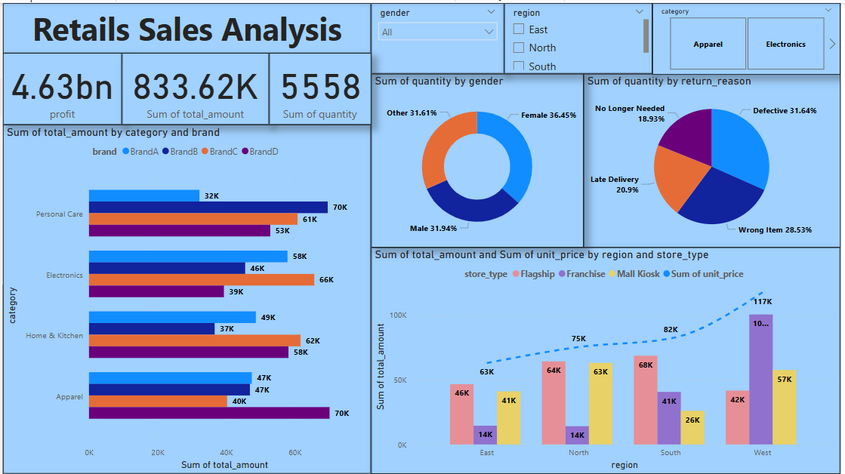
Retails Sales Analysis Dashboard

Slide 13
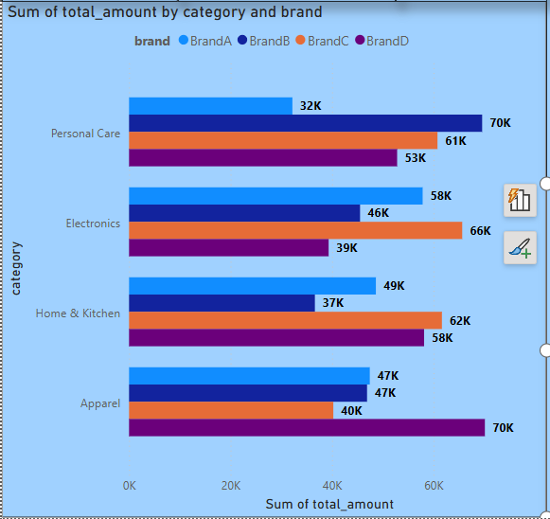
Brand Performance Overview Across Product Categories: An evaluation of total sales across categories reveals notable performance trends. In Personal Care and Apparel, BrandD emerged as the top performer, generating ₹70K in each category while BrandC registered the lowest figures in Electronics (₹39K) and Apparel (₹40K)

Slide 14
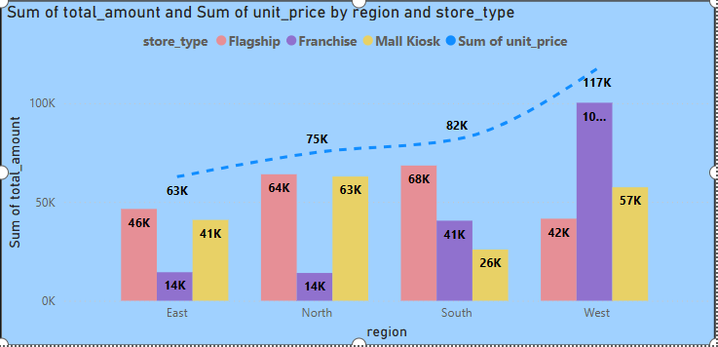
Regional Sales & Unit Price Analysis by Store Type: The analysis of total sales and average unit price across regions and store types reveals significant performance variations. The South Region leads overall sales, with Flagship stores contributing ₹68K and Mall Kiosks adding ₹26K bringing strong diversity in channel performance. The unit price peaks in the West Region (₹117K), possibly indicating either premium product mixes or higher pricing strategies in that zone.

Slide 15
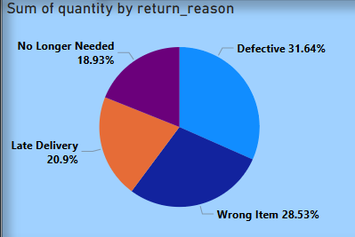
Analysis of Product Return Reasons by Quantity: The pie chart presents an analysis of product returns categorized by the reason for return. Among all return reasons, 'Defective' products account for the highest proportion at 31.64%Lastly, 'No Longer Needed' makes up 18.93% of the returns,

Slide 16
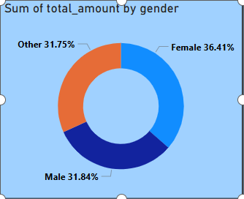
Distribution of Total Purchase Amount by Gender: The largest contribution comes from Female customers, accounting for 36.41%, The ‘Other’ gender category represents 31.75% is lowest.

Slide 17
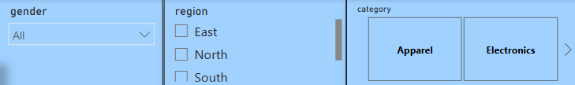
Interactive Filter Panel for Sales Analysis Dashboard Gender Filter – Allows users to select a specific gender or view data across all genders. Region Filter – Provides checkboxes for selecting specific geographic regions such as East, North, and South, allowing for region-wise performance insights. Category Filter – Offers a toggle between major product categories: Apparel and Electronics, helping to analyze sales trends or return patterns based on product types.

Slide 18
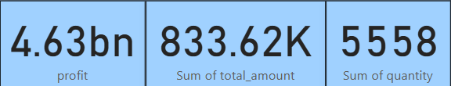
Key Performance Indicators Overview Sales Dashboard Profit: The total profit amounts to 4.63 billion, indicating strong overall business performance and effective cost management or high-margin sales. Sum of Total Amount: The total sales value stands at 833.62K, which represents the cumulative transaction value over a given period. This metric helps assess the revenue inflow and purchasing behavior of customers. Sum of Quantity: A total of 5,558 units have been sold or processed, highlighting the product movement volume. This can help analyze inventory turnover and product demand.

Slide 19
Conclusion
The Retail Sales Analysis dashboard provides a detailed overview of business performance across various dimensions, highlighting both strengths and improvement areas.
Profitability stands strong at 4.63 billion, with a total transaction value of 833.62K and 5,558 units sold, indicating high business volume and efficiency.
Gender-based Insights reveal that female customers contribute the most (36.45%) to total quantity sold, followed closely by male and other genders. This suggests the potential for targeted marketing strategies to female consumers.
Return Reasons Analysis shows that 'Defective' products (31.64%) and 'Wrong Item' deliveries (28.53%) are the top return reasons. This calls for stricter quality control and more accurate order fulfillment processes.
In terms of category performance, Personal Care and Apparel emerge as the top contributors in total sales, with BrandD showing consistent high performance across all categories—especially in Apparel and Personal Care.
Regional & Store Type Insights indicate that the West region leads in both total amount (117K) and unit price, followed by the South region. Franchise stores dominate across most regions, but Mall Kiosks in the West show exceptional value, indicating a strong local customer base or demand surge.

